Slide 1
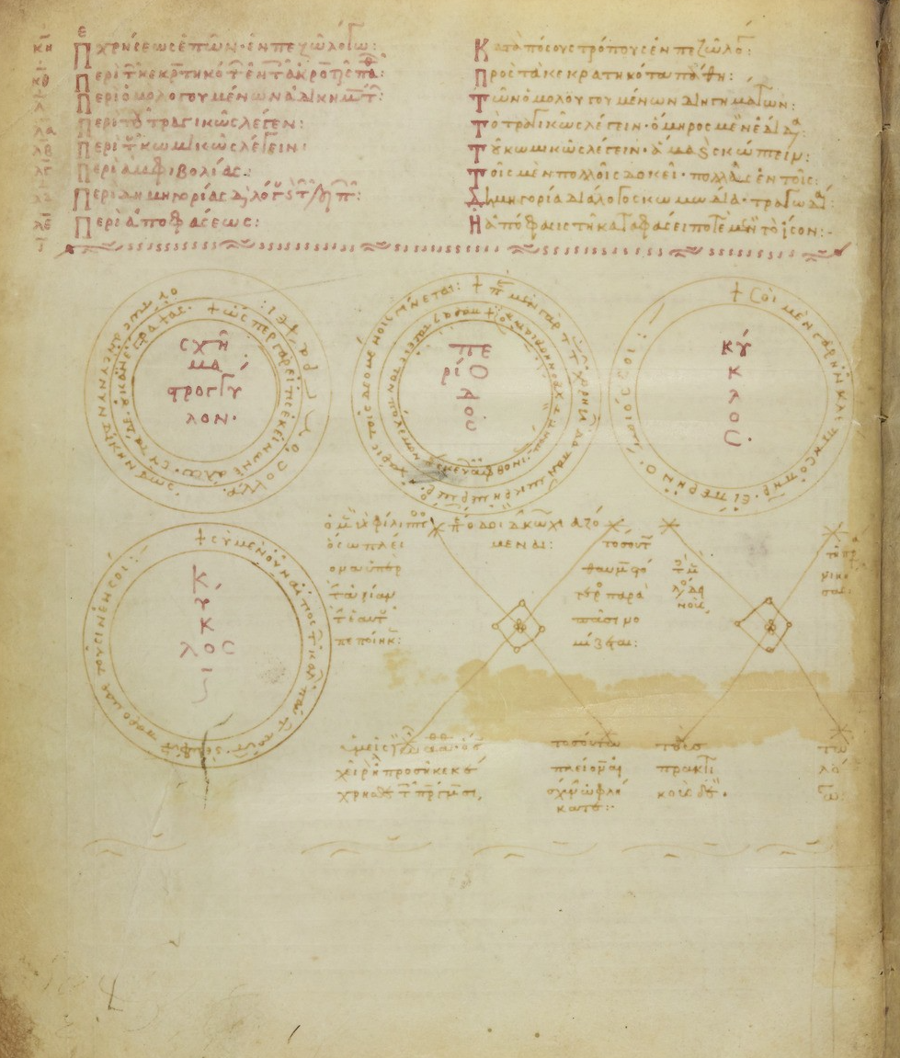
Necessity by design: the mathematics of rhetoric in Middle Byzantine culture
Visit to Max Plank Institute for the History of Science
Friday, 7 October 2022
14.00-15.00
R 265
Project supported by the Gerda Henkel Stiftung

Slide 2
A popular handbook
Corpus Hermogenianum (consolidated between the 5th and the 6th c.)
Authentic | Spurious | Aphthonios (4th-5th c.)
On the Issues, On the types of style (De ideiis) | On invention, On the method of forceful speaking | Preliminary Exercises (Progymnasmata)

Slide 3
A rich exegetical tradition
Corpus Hermogenianum
Late Antiquity | PScholia | Middle Byzantine Commentators | Late Byzantine Commentators
Menander of Laodicaea (3rd c.) Evagoras (4th c.) Aquila (4th c.) Epiphanius (4th c.) Eustathius (4th c.) Athanasius (4th c.) So-called Drei Männer Kommentar (Sopatros 4th c., Syrianus 5th c., Marcellinus 5th) George Monos (5th c.) John of Caesarea (5th c.) Photios (5th c.) Phoibammon (5th c.) Cf. Cristina Pepe, The Rhetorical Commentary in Late Antiquity, Aion 40 (2018) 86–108. | Par. Gr. 1973 (10- 11th c.), 2916 (11th c.), 2977 (13th c.); Neap. II E 5 (late 12th?) | John of Sardis (9th c.), unedited John Geometres (10th c.) preserved through indirect quotations John Sikeliotes (11th c. first half), commentary on De ideiis, Walz 1834 John Doxapatres (11th c.) unedited; accessus Rabe 1931; John the Logothete (12th c. first half) unedited Gregory of Corinth (12th c. first half), commentary on De ideiis, Walz 1837 John Tzetzes (1113-1183?), unedited, commentary on De ideiis Barili, in preparation | Maximos Planudes (1260-1305) ed. Walz 1833 Joseph Rakendytes (1260/80-1330) trad. Valiavitcharska in preparation George of Trebizond (1395-1486) print ed. 1523; bio: Monfasani 1976, 1984

Slide 4
Rhetoric, geometry, medicine, a fluctuating epistemic status
Sopatros, Commentary on Hermogenes’ On the Issues Walz 4 1933, pp. 79-80 And again because also the philosophers dispute (amphisbetousi) through words, and the doctors and the geometers, and everyone else who take part into the sciences of the word (epistemas) and puts forward a further different opinion by speaking.
PScholia Walz 7 1834, p. 13: Science (episteme) has just one way toward truth, like the geometers who want to teach about triangles, they have just one goal and one way of demonstrating it (mian apodeixin) even if they are many. Rhetores on the contrary do not have the are not moved by the same goals – neither in relation to themselves nor in relation to the others – but are often set against each other.
Rhetorica anonyma, 11th c. (perhaps Doxapatres) Rabe 14 1931, p. 31 Further, because the rhetor is not alone in having what is persuasive (to pithanon), but also both medicine and geometry have it, for even the demonstrations (apodeixeis) ought not to be presented in a non persuasive way but must be persuasive.
John Doxapatres, Introduction to Aphthonios’ Progymnasmata Rabe 14 1931, 127 Some say that the work of rhetoric is to create the premises for benevolence and attention and disposition to learning, to expound with clarity to promote trust (pistis) and to foster memory; the Geometres criticizes these people saying that they are completely mistaken as regards what they think of premises, exposition and the other experts (technitais). And these are the works of rhetoric: the goal is not to convince but to speak persuasively without leaving aside any relevant argument (mhden twn endexomenwn). Other however say that the goal of rhetoric is convincing (peithw) and its tool trust (pistis).
John Tzetzes, Commentary on the corpus (Issues), Voss. Gr. f. 41 r. He said “partially” because of the arts of the philosophers and geometers, which we know to be completely controversial (amfisbetetous).

Slide 5
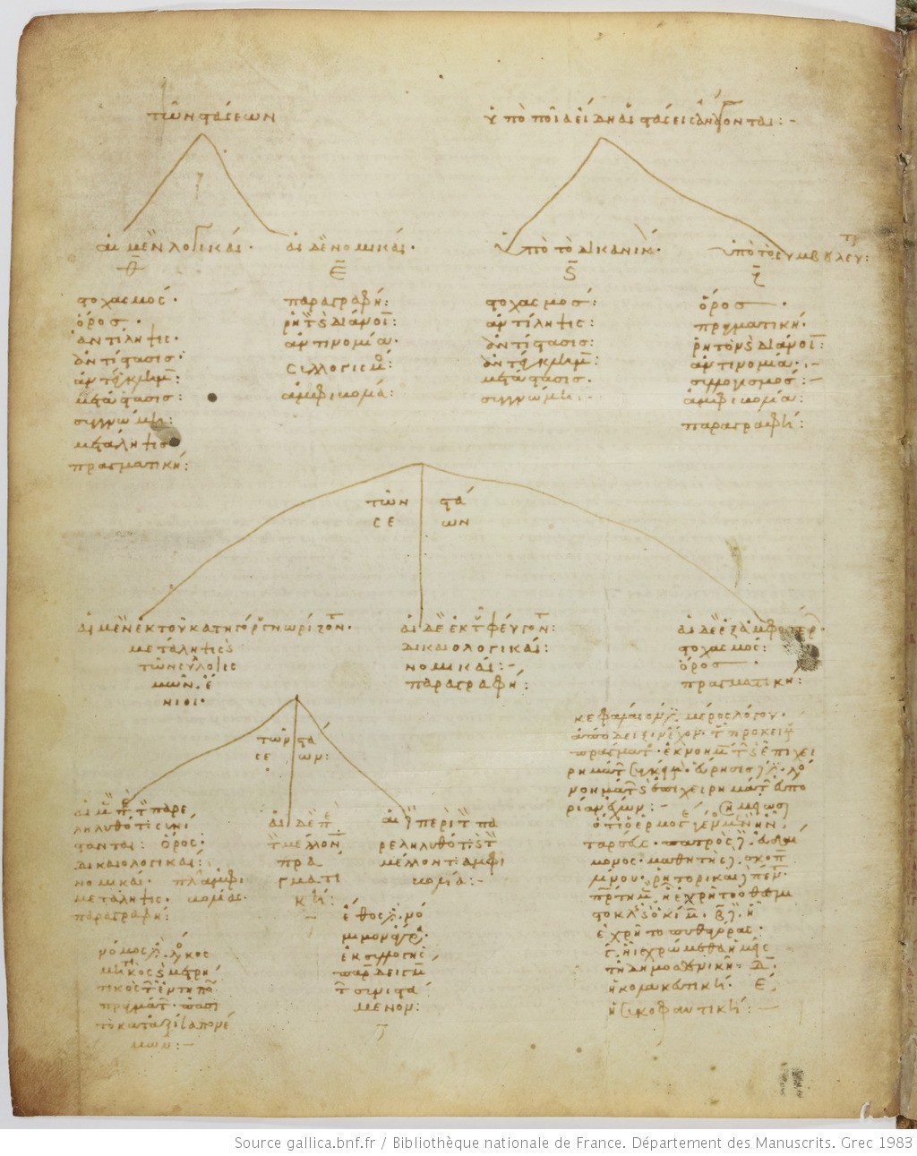
..and visualisation strategies
Ms. Paris. Grec 1983, 10th c., - f. 7v
Diagrammatic representation of Hermogenes’ stasis system

Slide 6
Ms. Paris. Grec 1983, 10th c., - f. 10r
Diagrammatic representation of Hermogenes’ stasis system

Slide 7
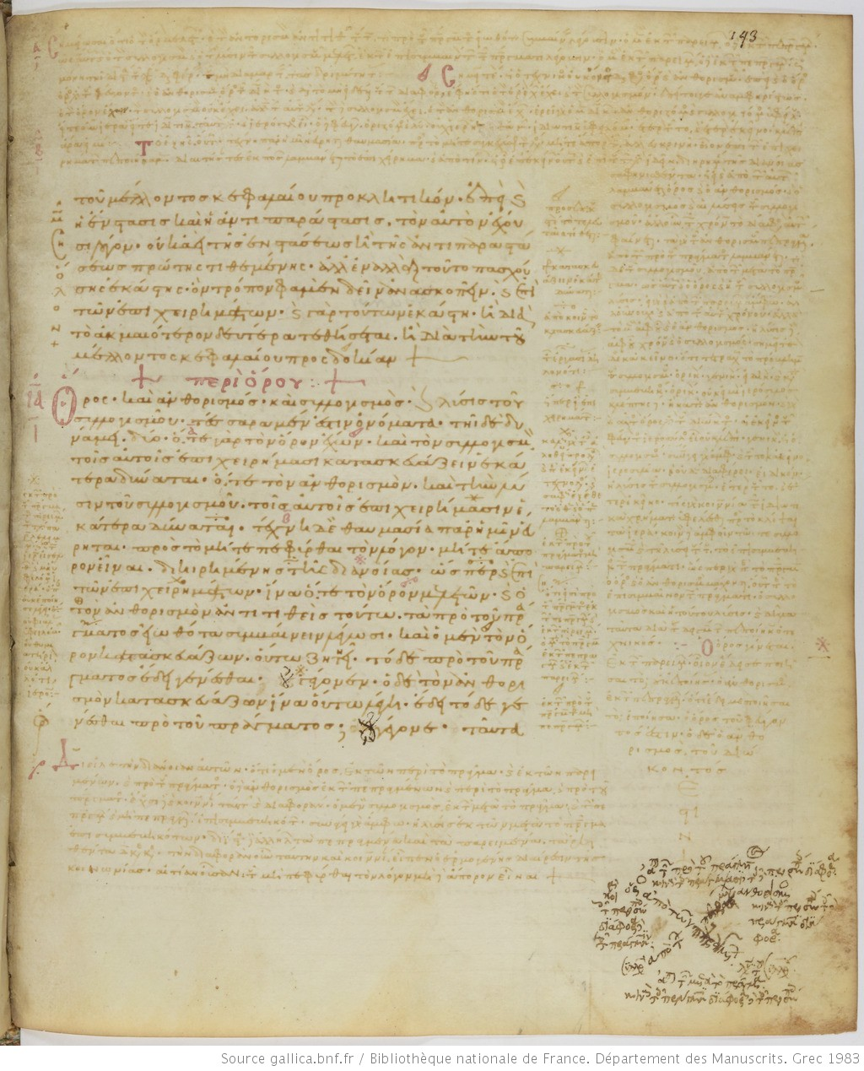
Ms. Paris. Grec 1983, 10th c., - f. 145r

Slide 8
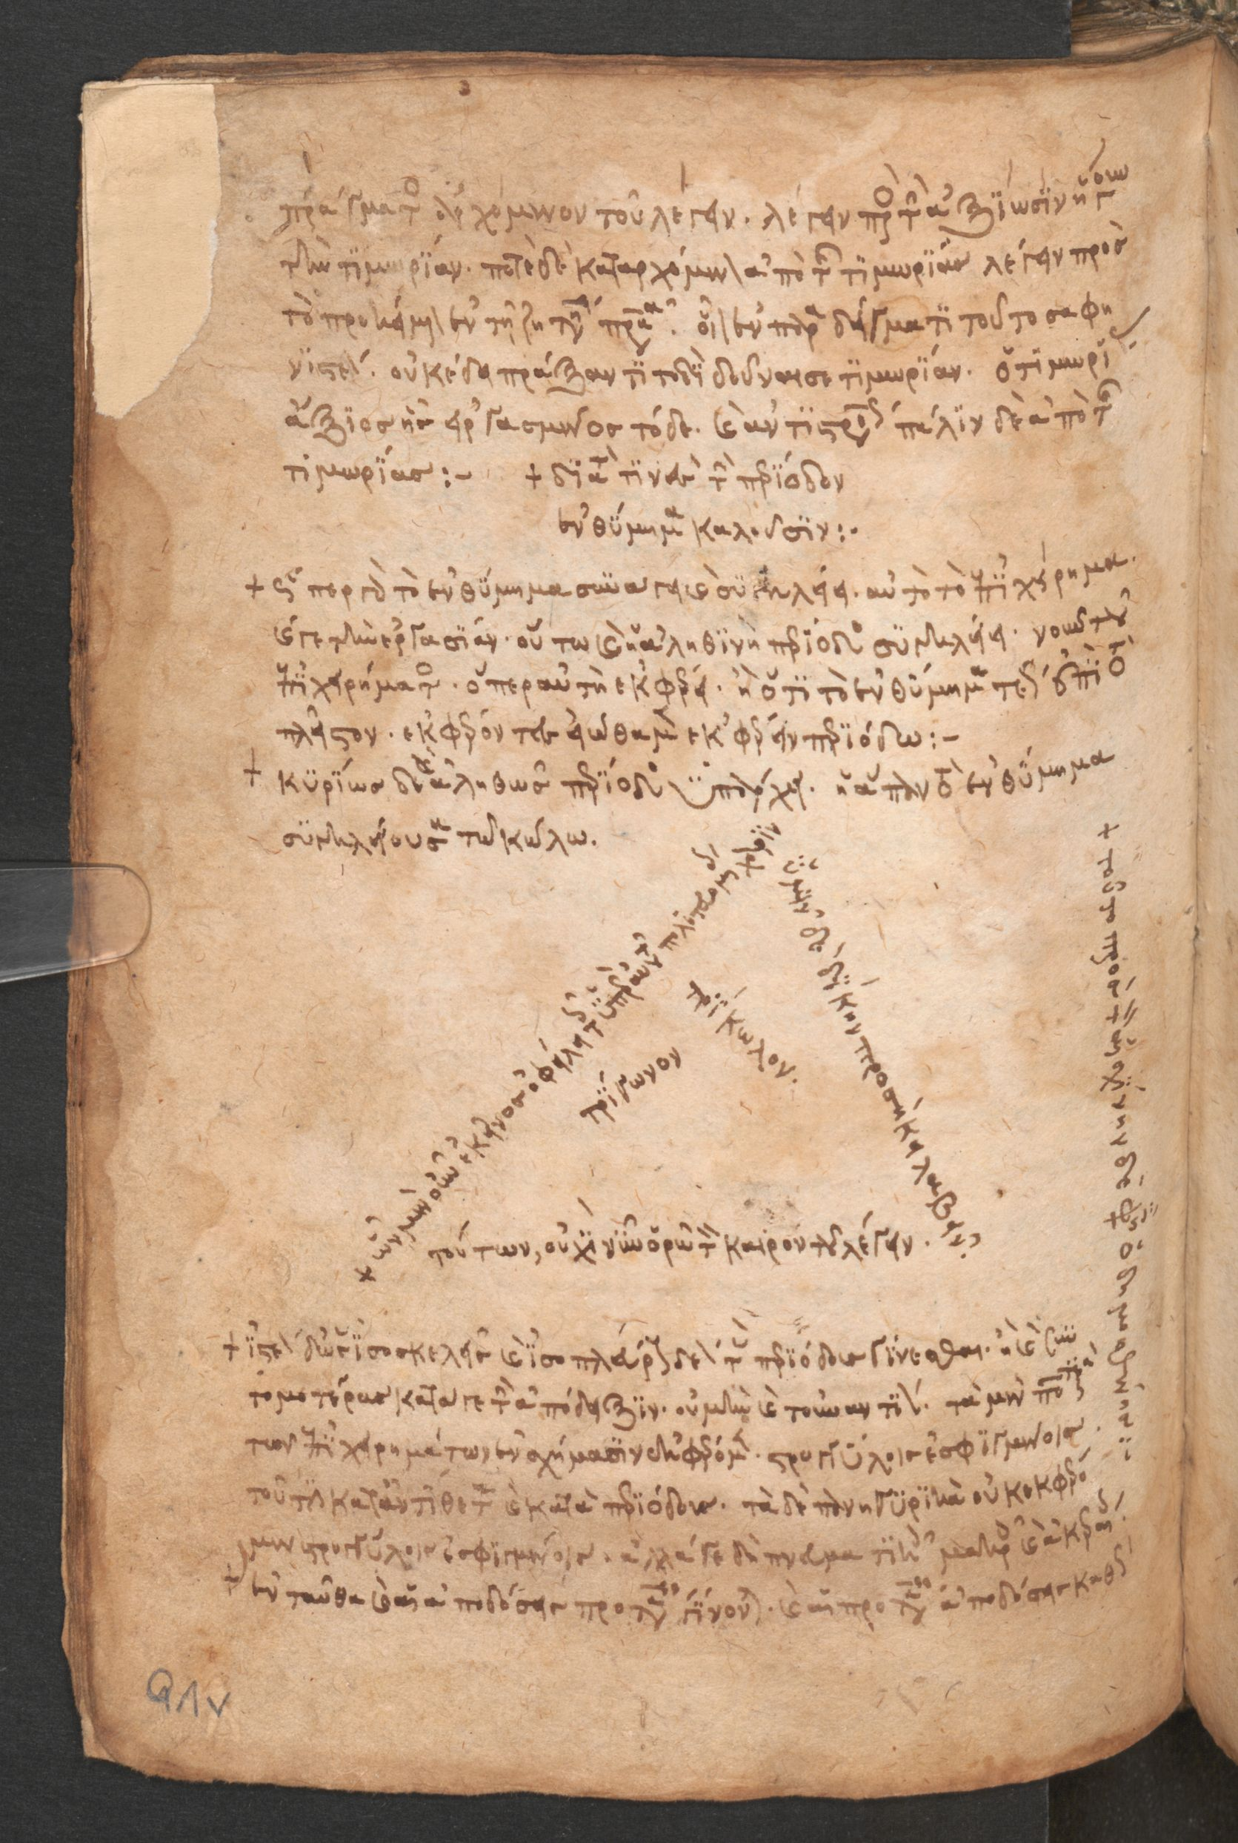
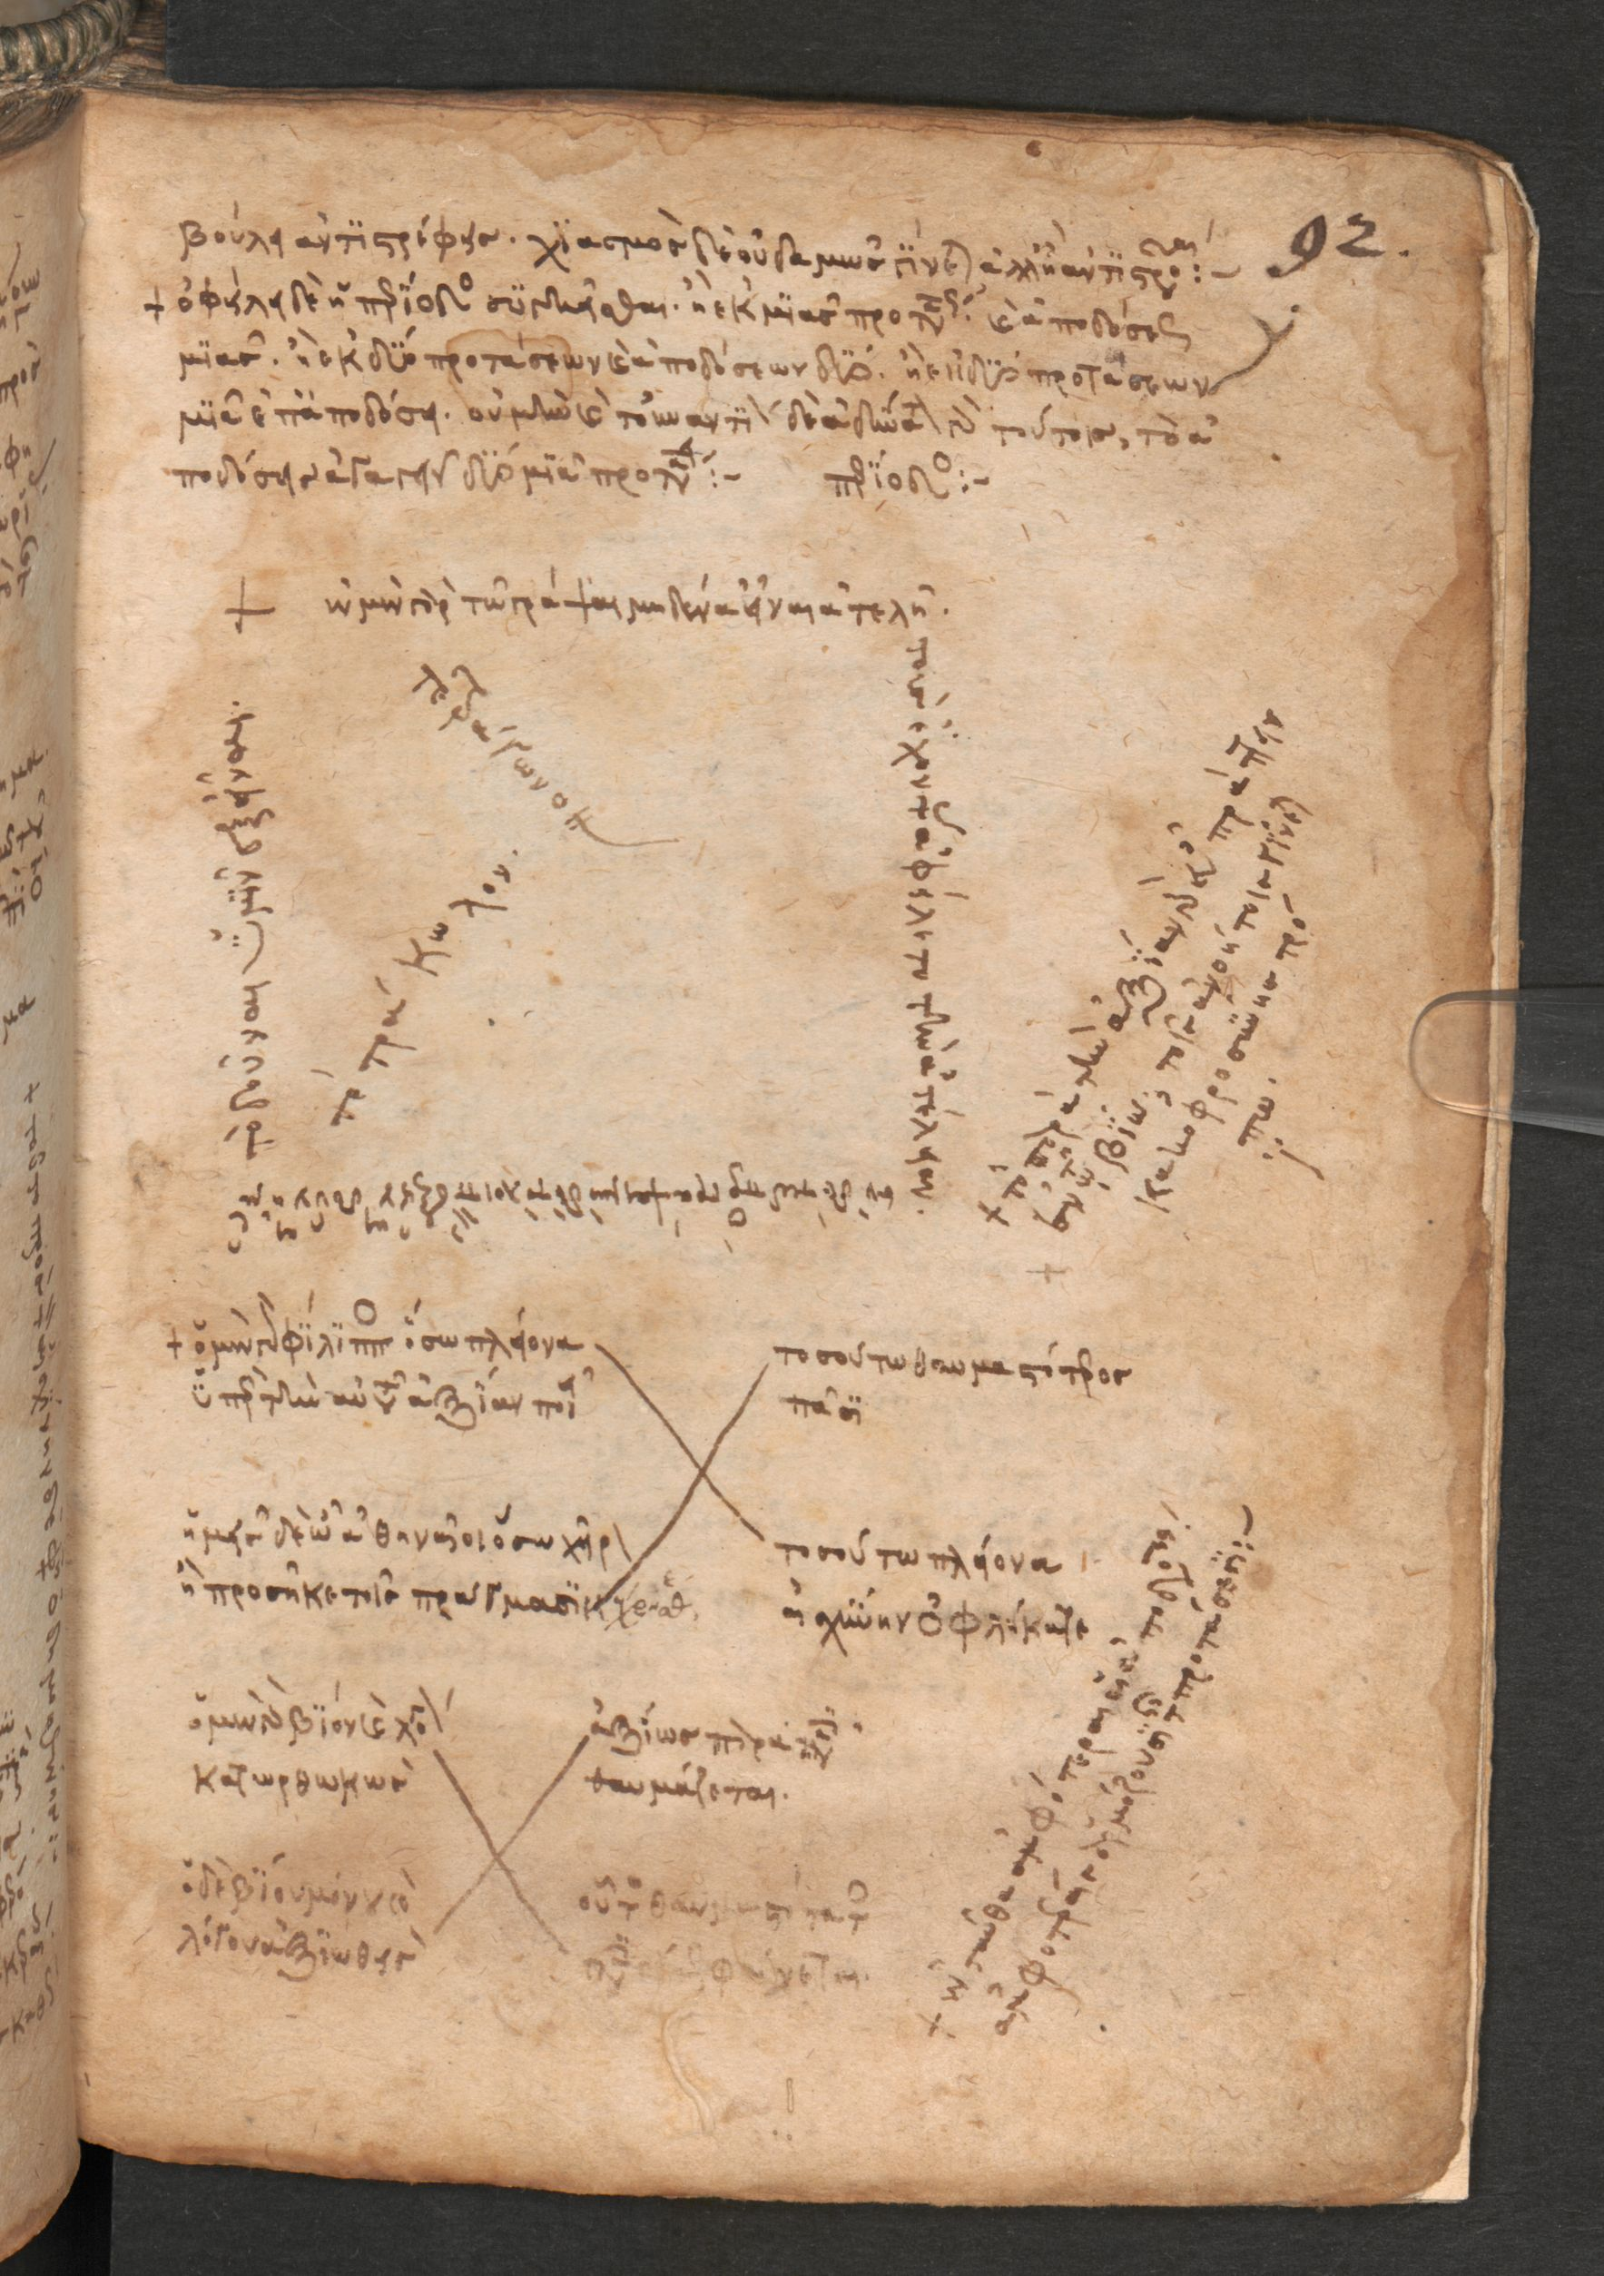
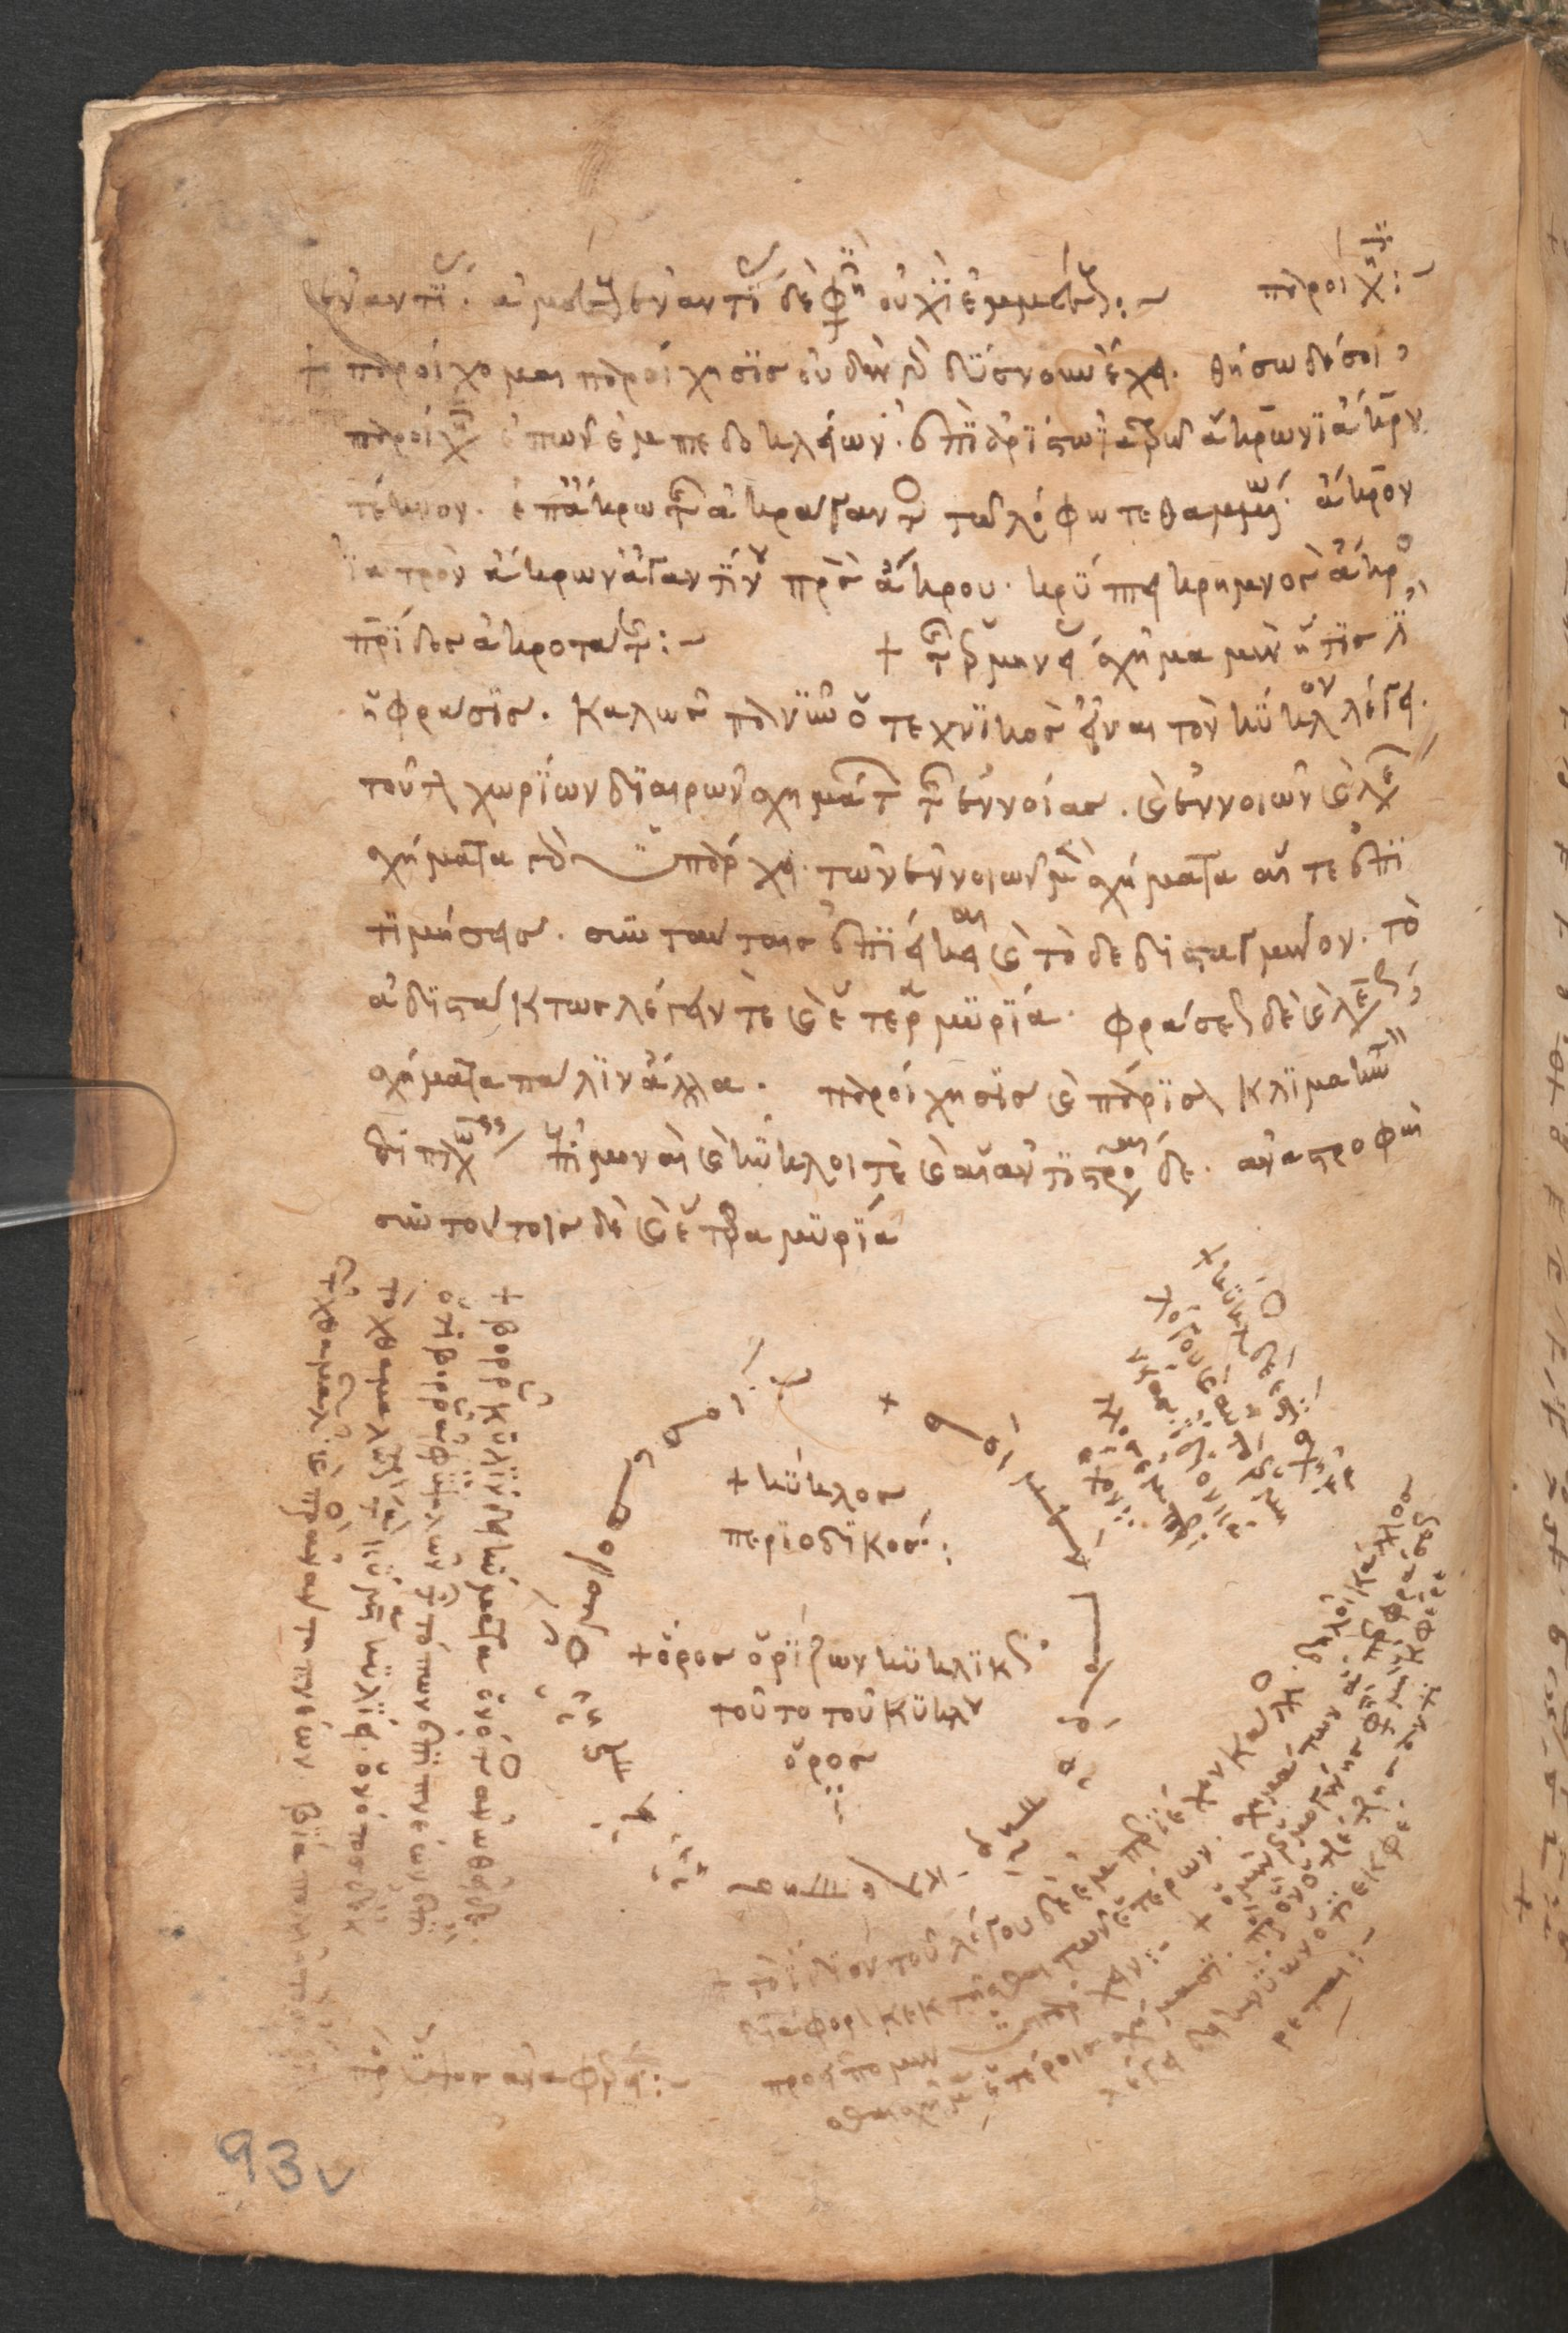
The project will explore the cognitive tools that contributed to bringing rhetoric closer to mathematics and will look both at discursive definitions (WP 1.1) and visualizations strategies such as graphs, diagrams and tables (WP 1.2) in the manuscripts of the Corpus and of its commentaries. In so doing this project shows that Byzantine intellectuals were very aware of the complex interaction between different discursive modes. To put it with Davis and Hersh (1987, 54), in Byzantium we certainly see how “rhetoric may be sometimes mathematical and (…) mathematics may be sometimes rhetorical”.
Ms. Vind. Phil. gr. 300, 14th c.

Slide 9
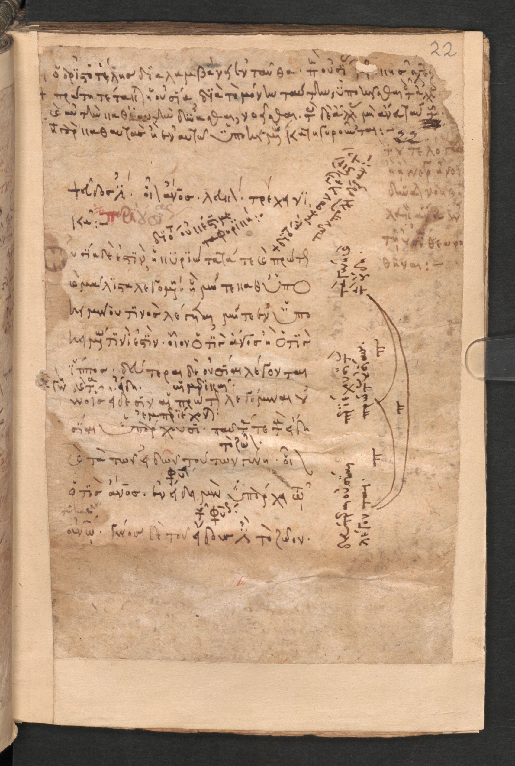
Ms. Vind. Phil. gr. 300, 14th c., - f. 22r

Slide 10
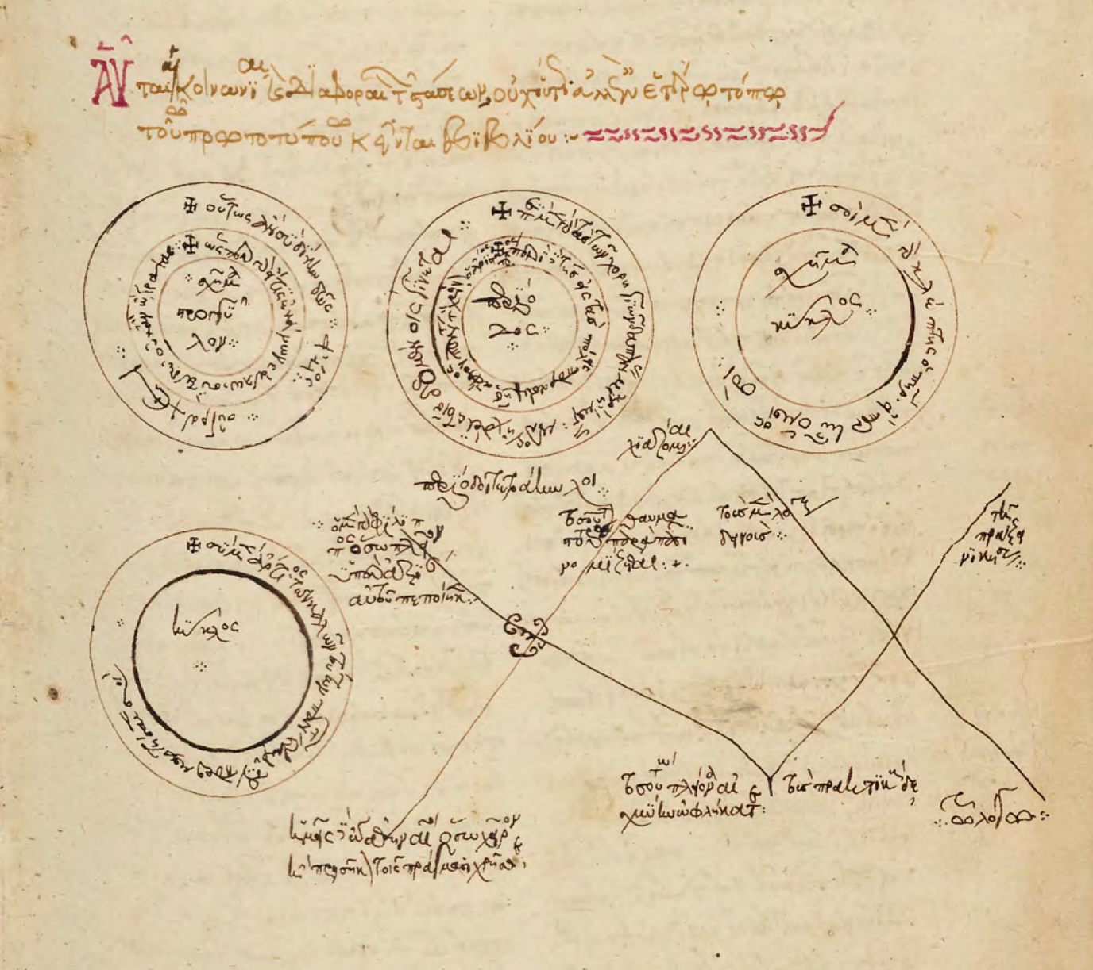
Ms. Voss. Gr. Q 1, f. 68r
Ms. Paris. Grec 1983, 9v

Slide 11
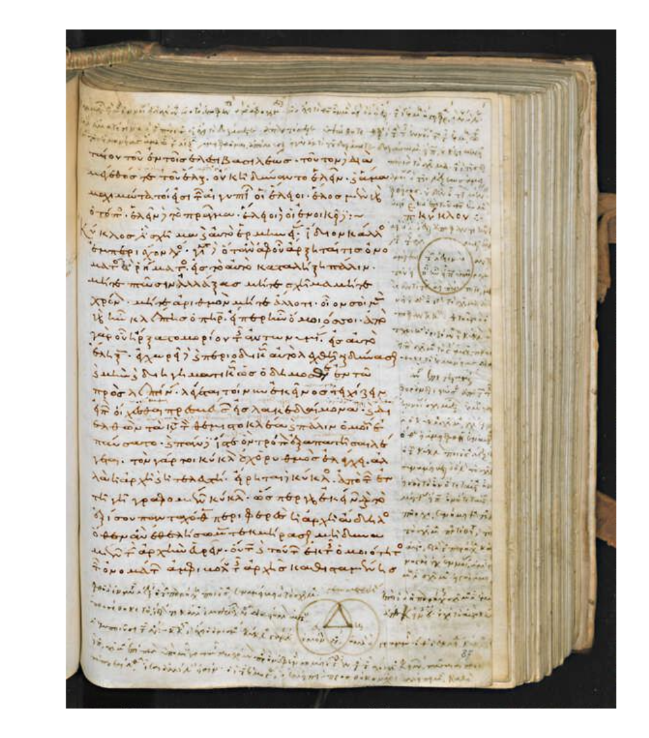
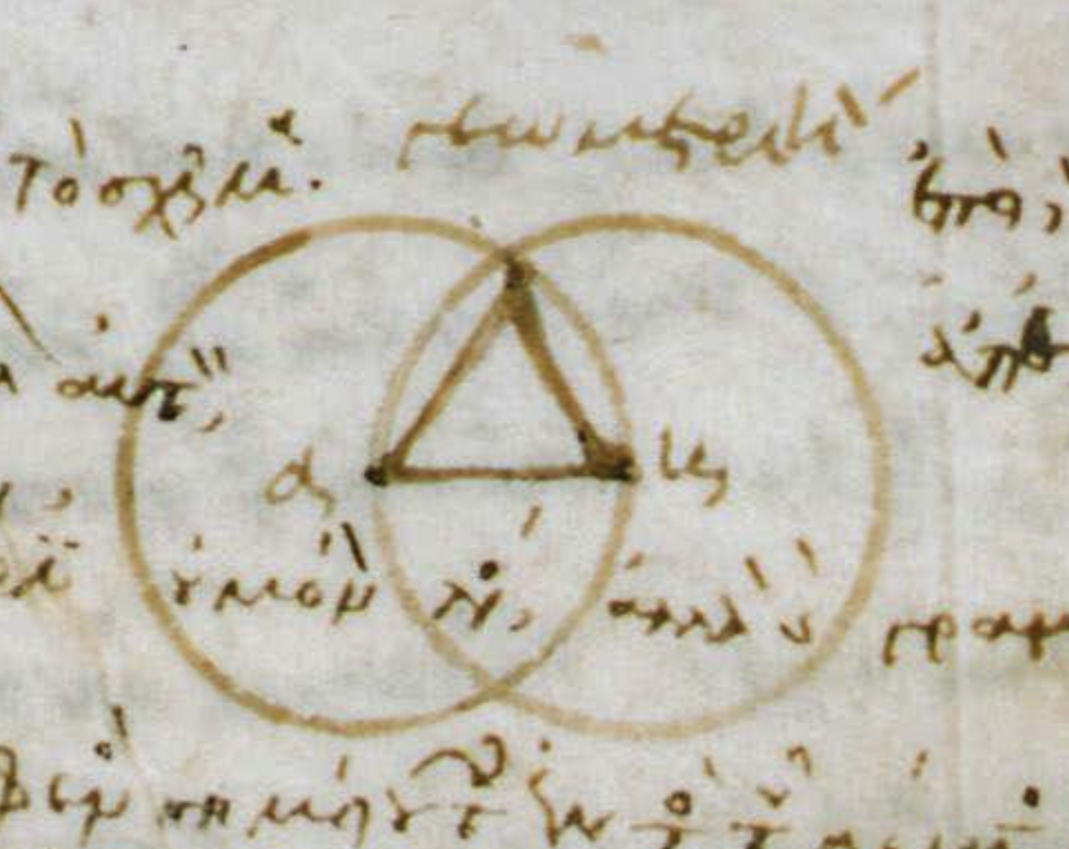
Ms. Laur. Plut. 60.15, 11th c., - f. 87r

